Slide 1
GRAM POSITIVE COCCI Streptococcus pneumoniae
Dr.R.S.Gopika M.D. (Hom.)
Professor & HoD
Dept. of Pathology
SKHMC

Slide 2
Streptococcus pneumoniae
pneumococcus
Gram-positive
encapsulated
Diplococcus
flame shaped
1µm
normally found in the nasopharynx

Slide 3
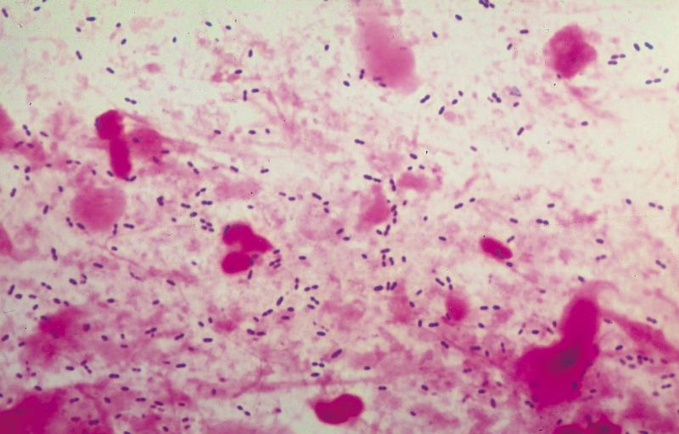

Slide 4
Quellung reaction
Neufeld/ capsular swelling reaction
To the pneumococcal colonies type specific antiserum along with methyelene blue is added .
In presence of homologus antiserum capsule swells,sharply delineated .
Bed side sputum test.

Slide 5
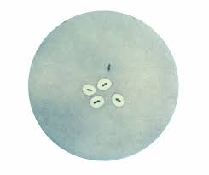
Quellung reaction

Slide 6
Culture- characters
37ºC, pH- 7.8 , CO₂ -5- 10%
Glucose broth - uniform turbidity
Blood Agar -
18 hrs – small dome shaped, glistening, alpha haemolysis.
further incubation – colonies flat ,raised edges, central umbonation – carrom coin/draught man’s colonies.

Slide 7
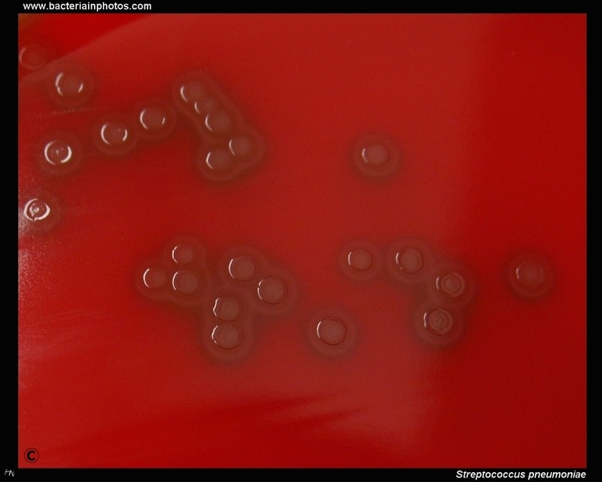
Blood agar
5% CO₂, overnight.
Colonies are surrounded by zones of alpha-hemolysis.

Slide 8
Resistance
52º C -15 min

Slide 9
Virulence factors
Polysaccharide capsule—prevents phagocytosis
Pneumolysin -pore-forming protein that can cause lysis of host cells and activate complement
Autolysin -activation of this protein lyses the bacteria releasing its internal contents (pneumolysin)
Hydrogen peroxide—causes damage to host cells (can cause apoptosis in neuronal cells during meningitis)
IgA protease – cleaves resp mm IgA

Slide 10
Pili—colonization of upper respiratory tract and increase the formation of large amounts of TNF by the immune system during sepsis, raising the possibility of septic shock
Choline binding protein A / Pneumococcal surface protein A -an adhesin that can interact with carbohydrates on the cell surface of pulmonary epithelial cells and can inhibit complement-mediated opsonization of pneumococci

Slide 11
Pathogenesis
normal colonization can become infectious if the organisms are carried into areas such as the Eustachian tube or nasal sinuses where it can cause
otitis media and
sinusitis,

Slide 12
Pneumonia
occurs if the organisms are inhaled into the lungs and not cleared (viral infection, or smoking-induced ciliary paralysis might be contributing factors).
capsule makes it resistant to phagocytosis, alveolar macrophages cannot adequately kill the pneumococci.
The organism spreads to the blood stream/ bacteremia and is carried to the meninges, joint spaces, bones, and peritoneal cavity, and may result in meningitis, brain abscess, septic arthritis or osteomyelitis.

Slide 13
Age groups at highest risk for disease:
Infants and children < 2 years of age
Adults > 65 years of age

Slide 14
Acute otitis media
From colonisation to invasion of middle ear through the eustachian tube
Facilitated by previous viral infection
Mostly in young children with immature immune defence

Slide 15
pneumococcal pneumonia
The incubation period -1 to 3 days.
Symptoms
abrupt onset of fever and chills or rigors.
Other common symptoms include pleuritic chest pain, cough productive of mucopurulent, rusty sputum, dyspnea ,tachypnea ,hypoxia ,tachycardia and weakness.
Nausea, vomiting, and headaches occur less frequently.

Slide 16
Complications
Pleural effusions
Septicemia
Endocarditis
Meningitis

Slide 17
Invasive pneumococcal disease (IPD)
Bacterial growth in normally sterile fluids
Blood (pneumonia, meningitis, endocarditis)
CSF (meningitis)
Joint fluids (artritis)
Pleural fluid (pleuritis)
Peritoneal fluid (peritonitis)

Slide 18
Lab

Slide 19
ENTEROCOCCUS
Normal flora of human intestine
Diplococci Spectacle shapedappearnce
E.Faecalis
UTI,intra abdominal,pelvic and soft tissue infections
Infection on burn surfaces.

Slide 20
commons.wikimedia.org
en.wikipedia.org
Text Book of Microbiology-Anandanarayanan

